Slide 1
SOLAR INVERTER
Inverters used in photovoltaic applications are historically divided into two main categories:
Standalone inverters
Grid-connected inverters

Slide 2
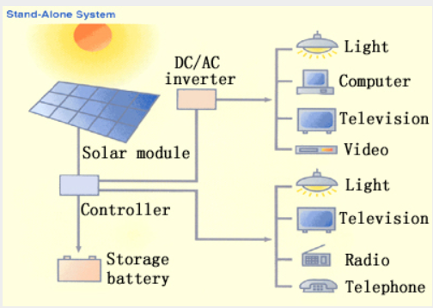

Slide 3
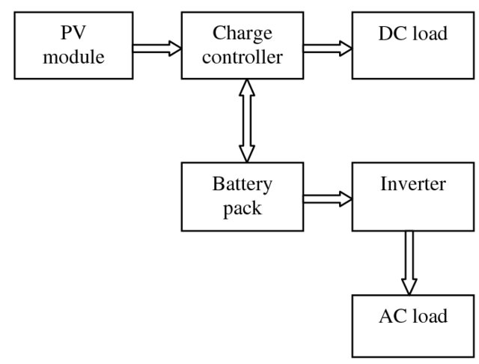
STAND ALONE INVERTERS

Slide 4
STAND ALONE INVERTERS
Stand-alone inverters are used in applications where the PV system is not connected to the main electricity distribution network.
These systems operate independently and supply electrical energy directly to the connected loads.
The primary function of the stand-alone inverter is to convert DC power from solar panels or batteries into AC power, while maintaining the stability of key electrical parameters such as voltage and frequency.
The inverter ensures that these parameters remain within predefined limits and is capable of withstanding temporary overloading conditions.
Since the system works independently of the utility grid, a battery storage system is typically integrated to ensure a reliable and consistent supply of energy even during periods of low or no sunlight. Stand-alone PV systems can either directly power loads during daytime using real-time solar energy or charge the batteries that act as the main energy storage device.

Slide 5
STAND ALONE INVERTERS WORKING
A typical stand-alone PV system consists of the following components:
Solar Panels: Mounted on rooftops or open spaces to capture sunlight and generate DC electrical power.
Battery Bank: Stores the DC energy produced by the panels for use when solar power is insufficient.
Charge Controller: Protects the battery from overcharging and ensures efficient charging and discharging cycles.
Stand-Alone Inverter: Converts stored or direct DC power to AC power suitable for household or commercial loads while maintaining stable operating conditions.
Overall, stand-alone inverters enable self-sufficient power systems, making them ideal for remote locations, off-grid homes, and areas where reliable grid access is unavailable.

Slide 6
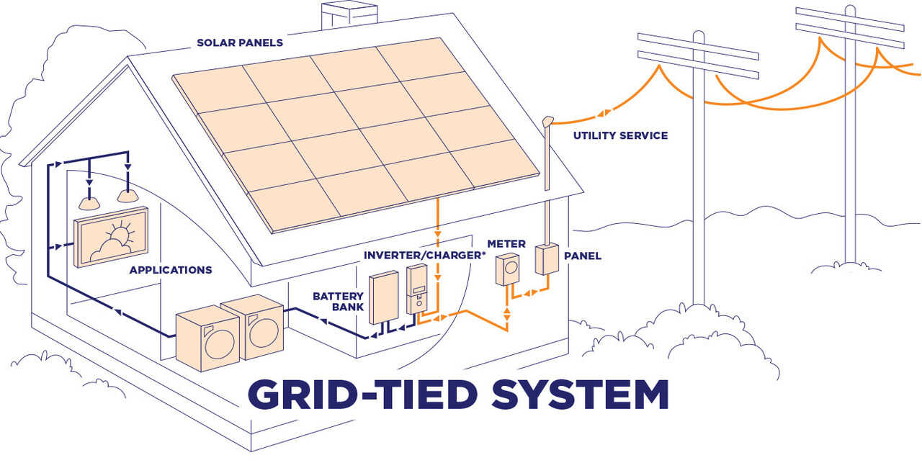
GRID CONNECTED INVERTERS

Slide 7
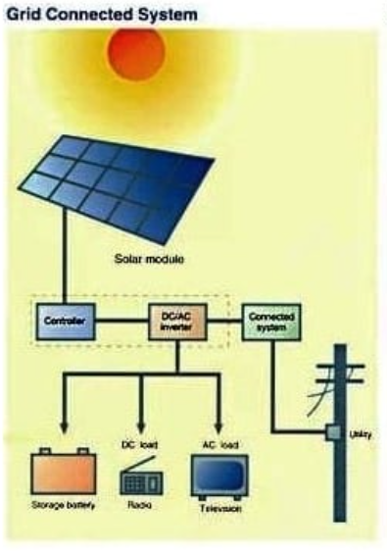

Slide 8
GRID CONNECTED INVERTERS
A grid connected photovoltaic system will be interacted with utility grid. The main advantage of this system is that power can be drawn from the utility grid and when power is not available from grid, PV system can supplement that power. These grid connected systems are designed with battery or without battery storage. These systems consist of the following:
Solar panels mounted on the roof or in open spaces. Photovoltaic modules produce direct current (DC) electrical power.
Batteries to store DC energy generated by the solar panels.
Charge controller to prevent overcharging the battery.
Specially designed inverter to transform the PV generated DC electricity to the grid electricity (which is of AC) at the grid voltage.

Slide 9
GRID CONNECTED INVERTERS WORKING
The primary component in grid-connected PV systems is the inverter, or power conditioning unit (PCU).
The PCU converts the DC power produced by the PV array into AC power consistent with the voltage and power quality requirements of the utility grid, and automatically stops supplying power to the grid when the utility grid is not energized.
A bi-directional interface is made between the PV system AC output circuits and the electric utility network, typically at an on-site distribution panel or service entrance.
This allows the AC power produced by the PV system to either supply onsite electrical loads, or to back-feed the grid when the PV system output is greater than the on-site load demand.

Slide 10
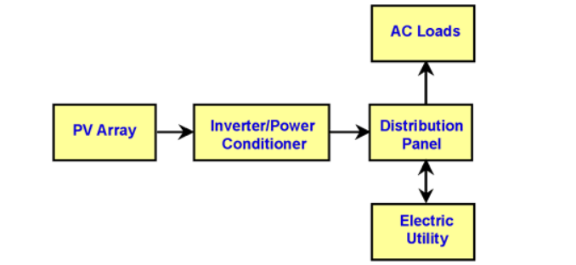
GRID CONNECTED INVERTERS WORKING
At night and during other periods when the electrical loads are greater than the PV system output, the balance of power required by the loads is received from the electric utility
This safety feature is required in all grid-connected PV systems, and ensures that the PV system will not continue to operate and feed back into the utility grid when the grid is down for service or repair.

